Slide 1

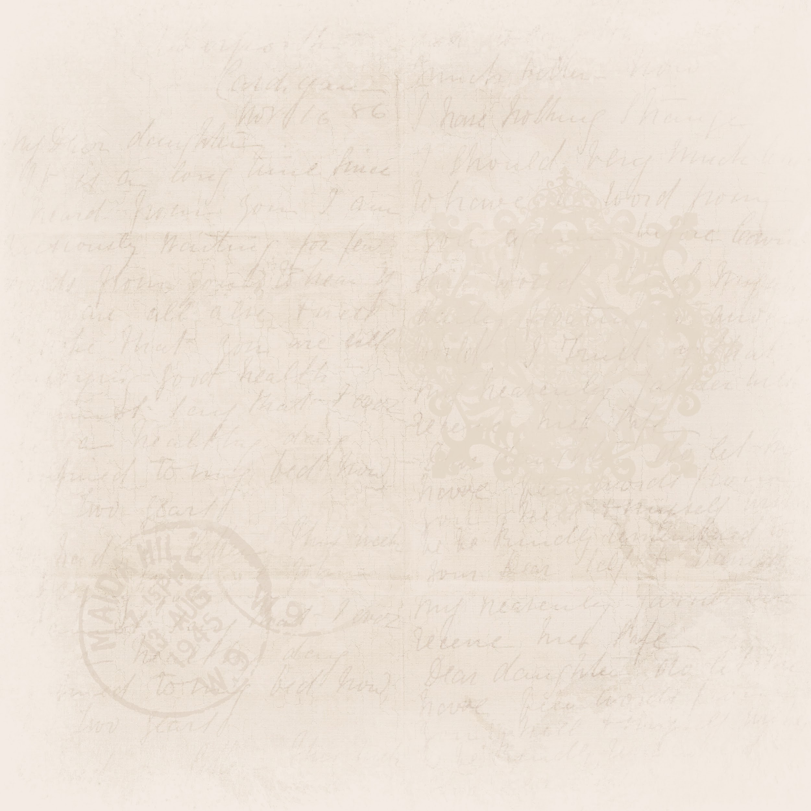



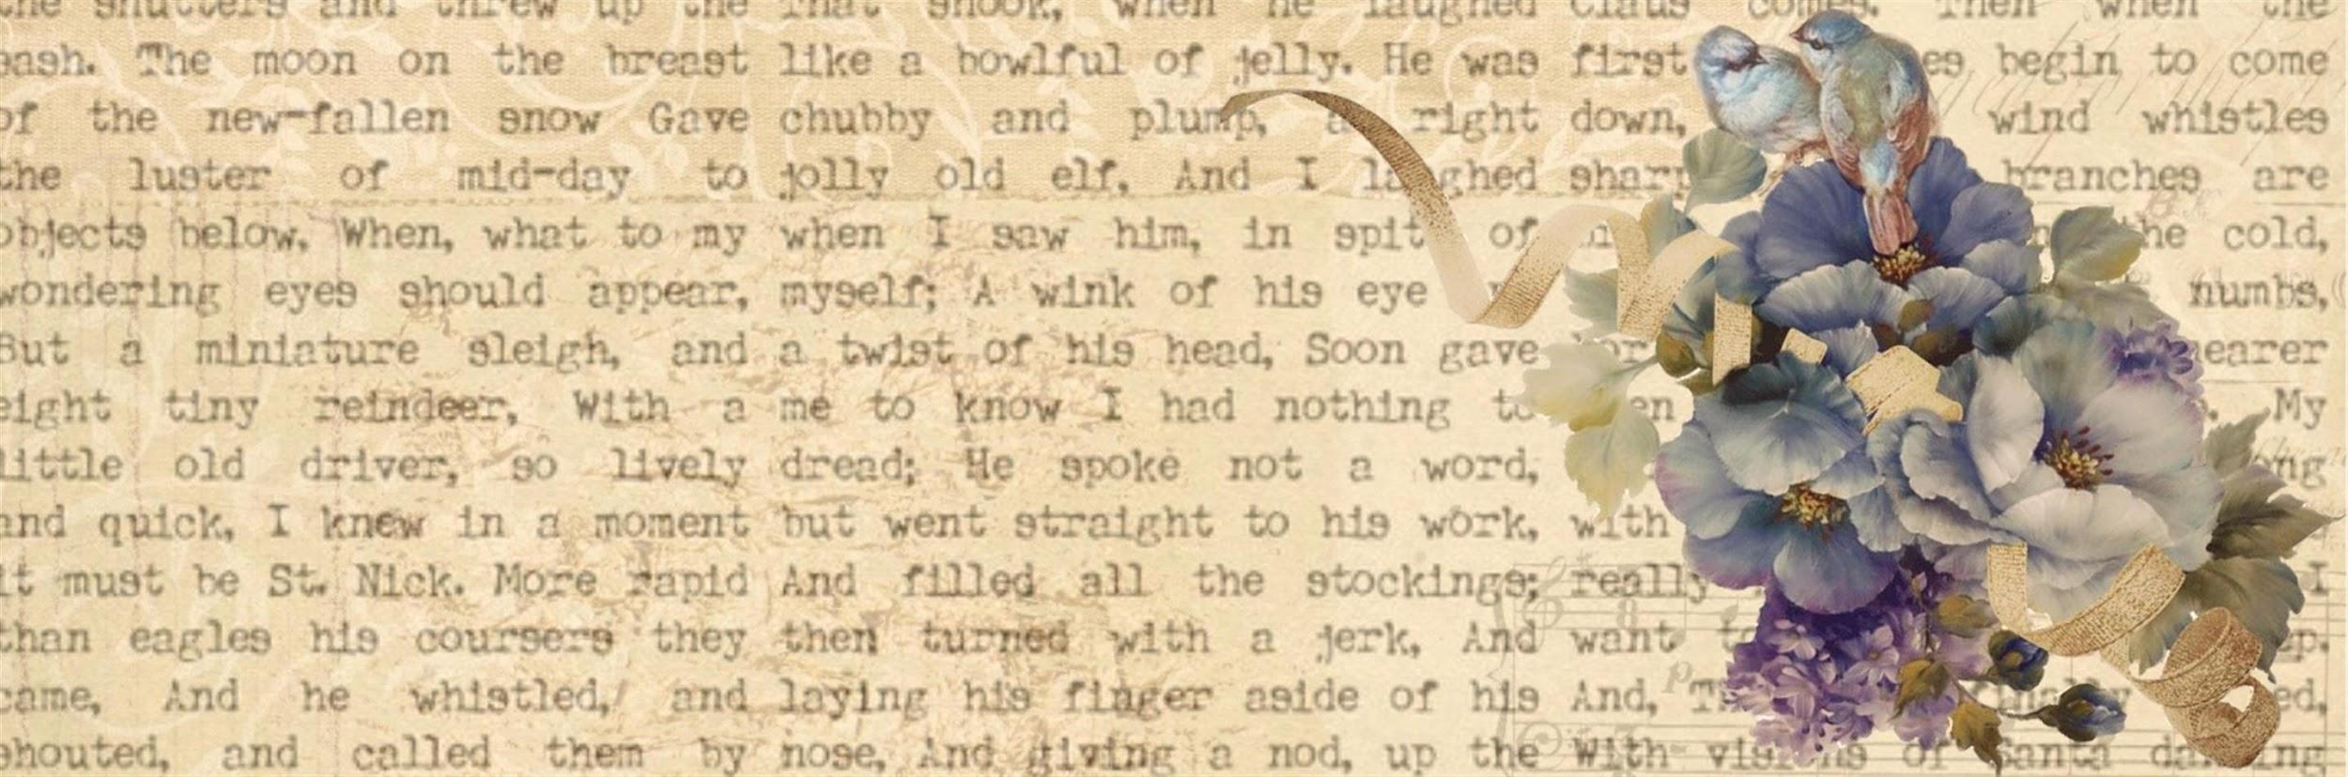






Vocabulary

Slide 2
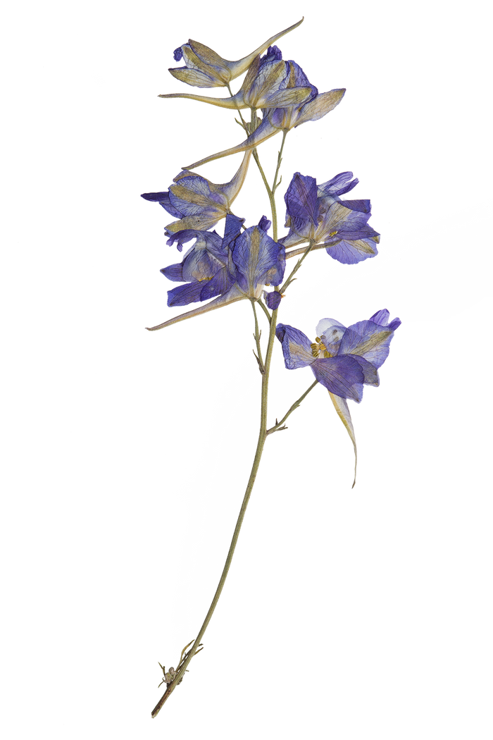
Synonyms?
Antonyms?

Slide 3
Synonyms
Synonyms are words that have similar or identical meanings.
For instance,Happy: joyful, pleased, delighted.

Slide 4
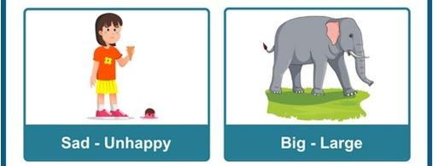

Slide 5
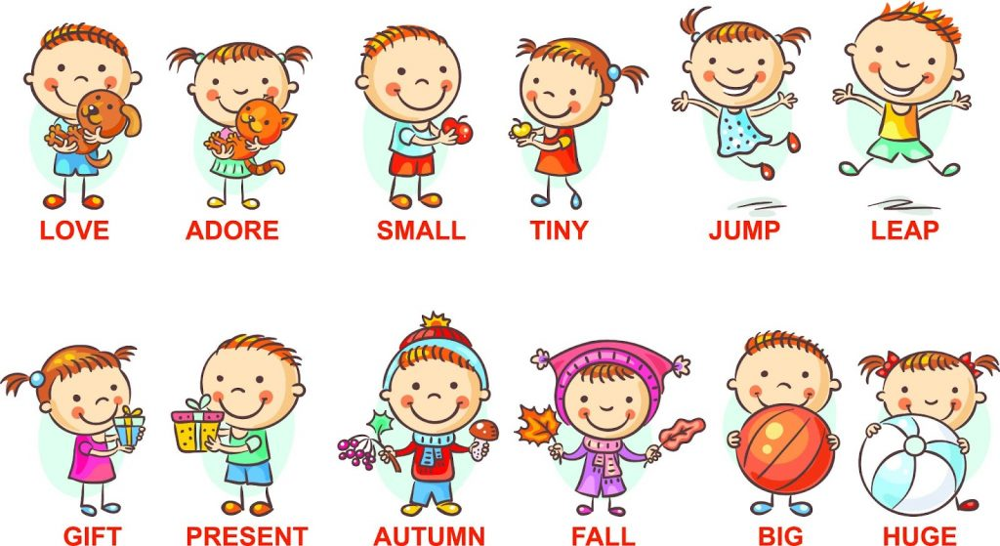

Slide 6
What is a synonym for “diligent”?
A) Lazy B) Indifferent C) Industrious D) Negligent

Slide 7
What is a synonym for “diligent”?
A) Lazy B) Indifferent C) Industrious D) Negligent

Slide 8
Which word is a synonym for "large"?
A) Tiny
B) Huge
C) Small
D) Little

Slide 9
Which word is a synonym for "large"?
A) Tiny
B) Huge
C) Small
D) Little

Slide 10
Which word means the same as "angry"?
Happy
Sad
Mad
Excited

Slide 11
Which word means the same as "angry"?
Happy
Sad
Mad
Excited

Slide 12
Choose the synonym for "brave".
A) Fearful
B) Cowardly
C) Bold
D) Timid

Slide 13
Choose the synonym for "brave".
A) Fearful
B) Cowardly
C) Bold
D) Timid

Slide 14
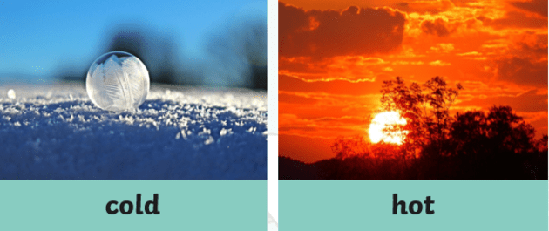
Antonyms?
Antonyms are words that have opposite meanings. They are used to express contrast or opposition between concepts.

Slide 15
More examples of Antonyms…
Happy: sad, unhappy, miserable, gloomy
Fast: slow, sluggish, unhurried, lethargic
Big: small, tiny, little, miniature
Smart: dumb, unintelligent, foolish, ignorant
Hot: cold, chilly, cool, freezing

Slide 16
What is an antonym for “ephemeral”?
A) Temporary B) Permanent C) Fleeting D) Transitory

Slide 17
What is an antonym for “ephemeral”?
A) Temporary B) Permanent C) Fleeting D) Transitory

Slide 18
Which word is an antonym for "fast"?
A) Quick
B) Swift
C) Slow
D) Rapid

Slide 19
Which word is an antonym for "fast"?
A) Quick
B) Swift
C) Slow
D) Rapid

Slide 20
Which word is an antonym for “strong"?
Robust
Tough
Weak
Powerful

Slide 21
Which word is an antonym for “strong"?
Robust
Tough
Weak
Powerful

Slide 22


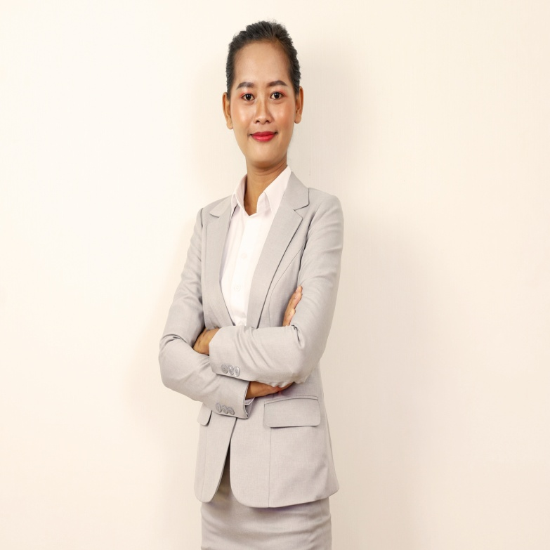
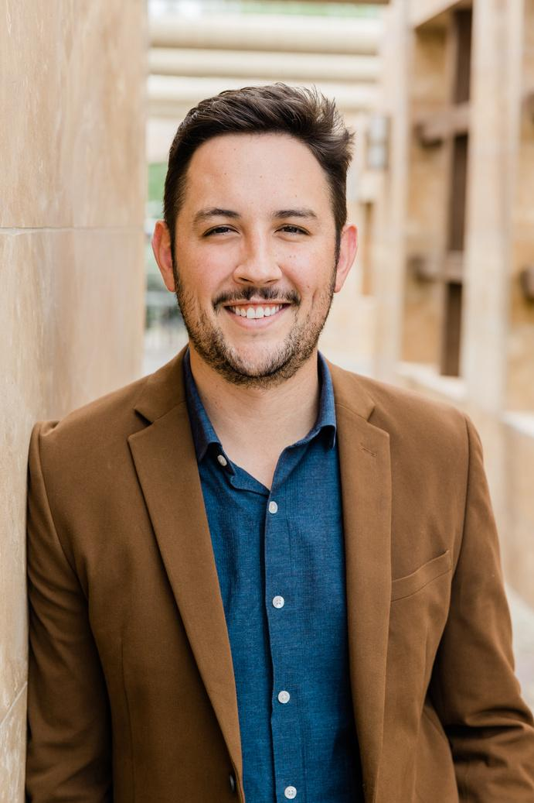



Importance of Synonyms and Antonyms
Enhancing Vocabulary
Improving Writing and Speaking Skills
Better Understanding of Language

Slide 23


Identification of Synonyms and Antonyms
Context Clues
Knowledge of Word Roots
Practice and Exposure
Knowledge of Prefixes and Suffixes
Understanding Contextual Pairs
Context can often provide hints about the meaning of a word and its possible synonyms.
Example: "The movie was fascinating and captivating.“
(Similar Context)
Understanding the roots, prefixes, and suffixes of words can help you identify synonyms.
Example: The prefix "un-" often indicates the opposite meaning, as in "unhappy" (not happy).
.
Exposure to various texts helps you encounter words in different contexts, aiding in understanding synonyms.
Example: Reading novels, newspapers, and academic articles will expose you to diverse vocabulary.
.
Many words naturally pair with their antonyms in common phrases or idioms.
Example: "The tall building dwarfed the small houses around it." ("Tall" and "small" are antonyms.)
Certain prefixes and suffixes indicate opposite meanings.
Example: Prefixes like "un-" (unhappy), "dis-" (disagree), "in-" (inconsistent), and "anti-" (antibiotic) often form antonyms.

Slide 24
Identify the odd one:
A) She felt happy and cheerful when she saw her old friends. B) Her feelings towards the job were a mix of excitement and apathy. C) She thanked him warmly and sincerely for his help. D) The explosion was deafening and thunderous.

Slide 25
Identify the odd one:
A) She felt happy and cheerful when she saw her old friends. B) Her feelings towards the job were a mix of excitement and apathy. C) She thanked him warmly and sincerely for his help. D) The explosion was deafening and thunderous.

Slide 26




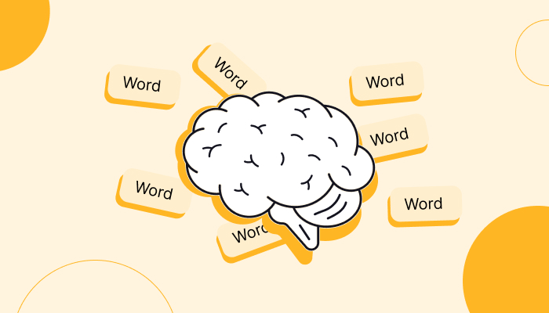

Ways to Improve Your Vocabulary
Develop a Reading Habit: Students come across new words while reading a novel or a newspaper article.
Dictionary and Thesaurus: Dictionaries can help students to learn about root words, related words, and antonyms.
Word Games: Word games such as scrabble are useful for students to expand and enhance their vocabulary.
Flashcards: Through flashcards they can make a number of words everyday to increase their vocabulary.
Use new Words in Conversation: They can use the words that they learn from reading or while watching TV in their conversation to remember them.

Slide 27
Thank
you

